Slide 1
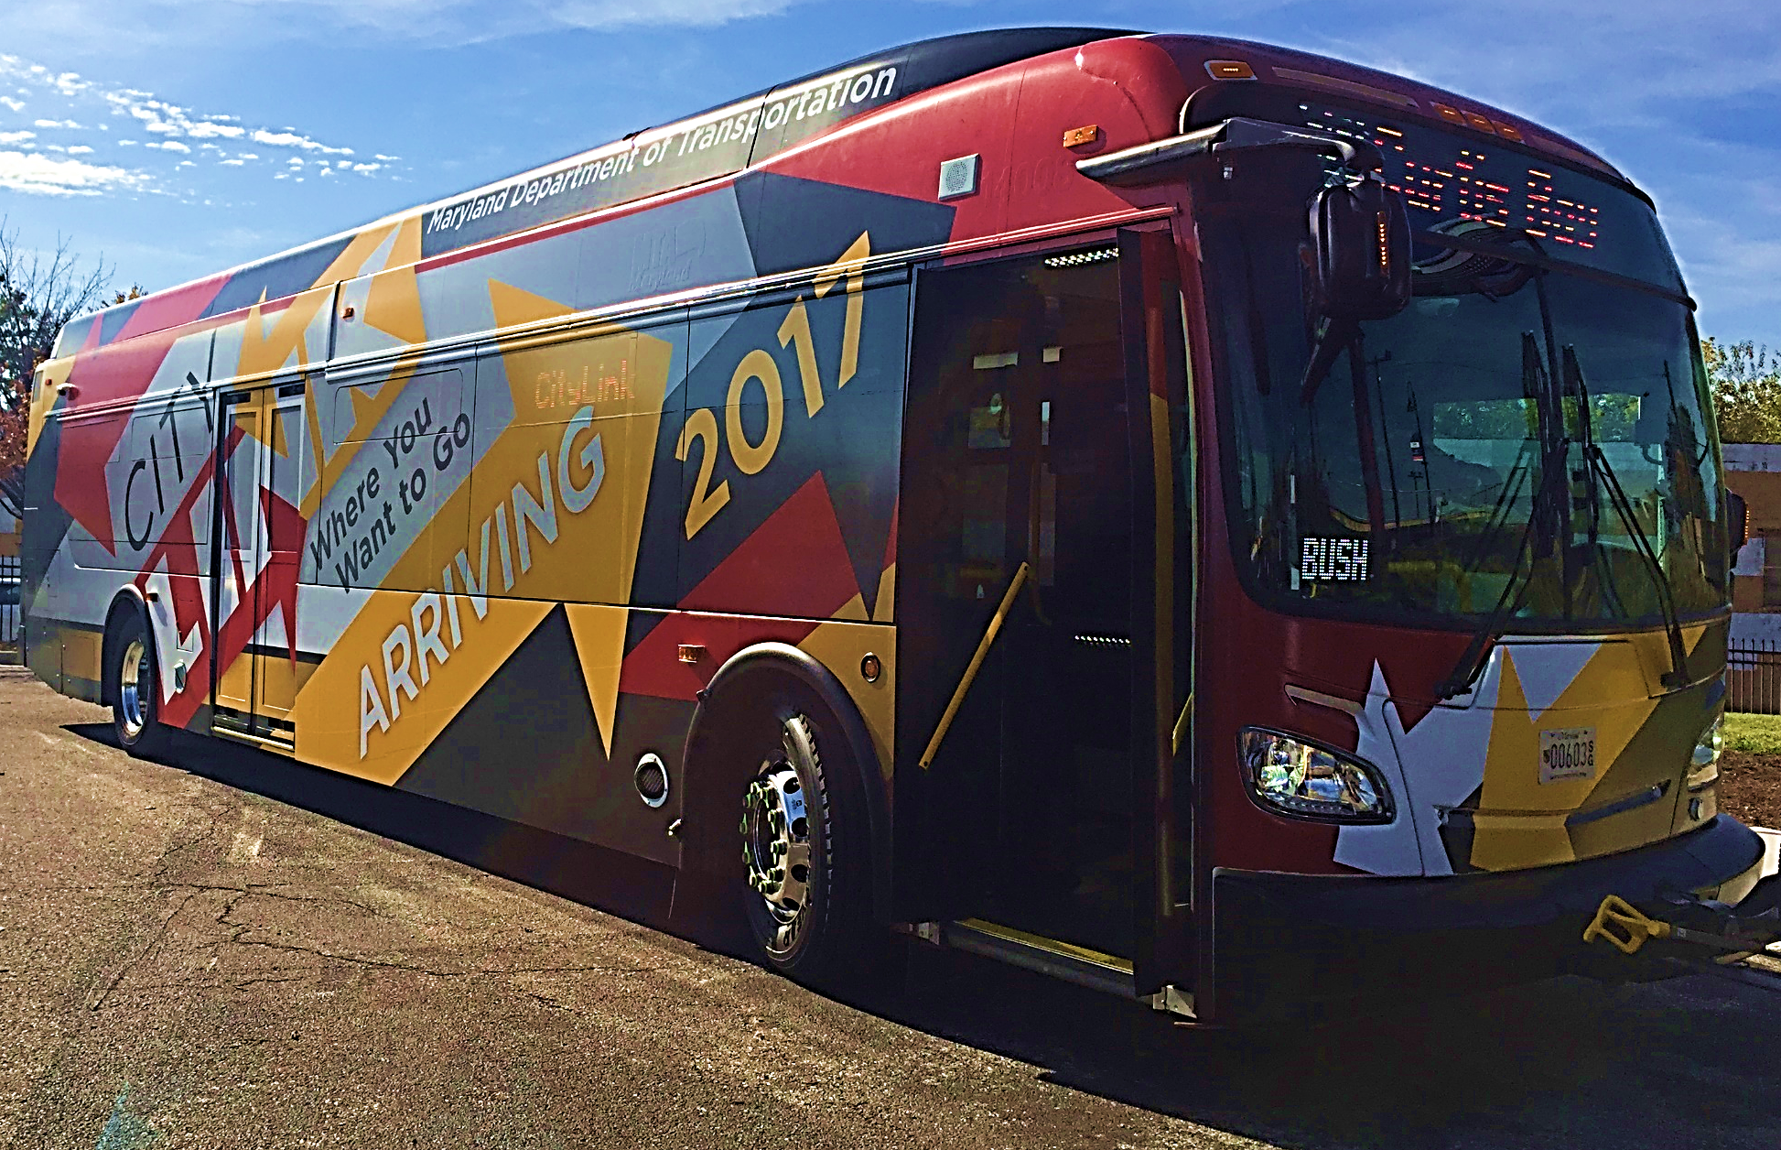
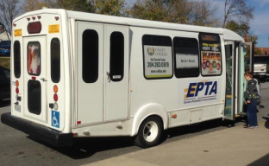
SYSTEM REDESIGN THE GOOD, THE BAD, AND WHAT COMES OUT OF THE CRACKS
Joshua Diamond, Project Manager/Lead Service Planner | April 20, 2016

Slide 2
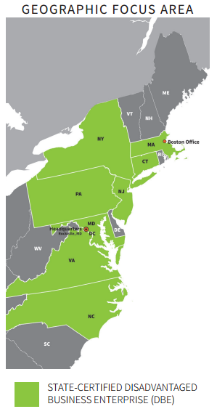
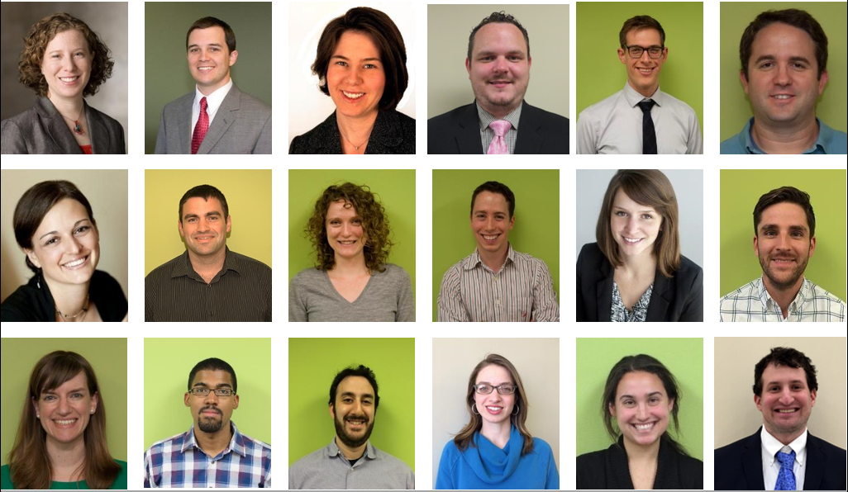
Woman-owned, DBE based in Rockville, Maryland
Founded in 2006
20 employees, 19 with significant planning experience
www.foursquareitp.com

Slide 3
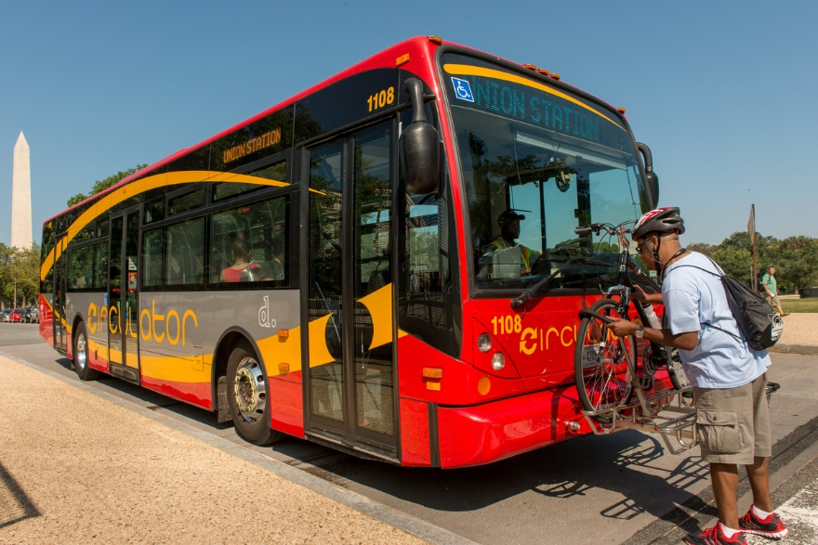
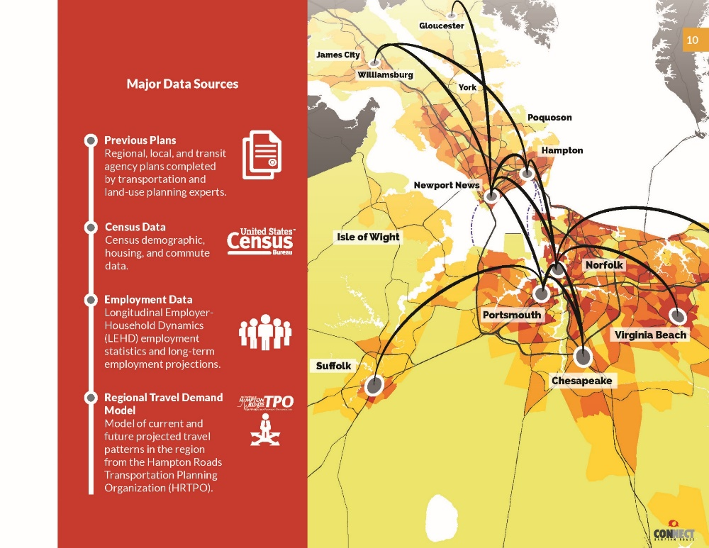
Our Service Planning Philosophy
PRIORITY GOAL: Fixing/establishing service for those with highest need
SECONDARY GOAL: Expanding service for choice riders
Methods:
Collaborative service planning
Quantitative/qualitative data symbiosis
Innovative techniques
Reliance upon “old school” planning methods—infused with and influenced by the latest technology

Slide 4
WHAT IS A SYSTEM REDESIGN?
BaltimoreLink
Eastern Panhandle Transit Authority
(EPTA) Transit Development Plan (TDP)
Blacksburg Transit
Route Analysis

Slide 5
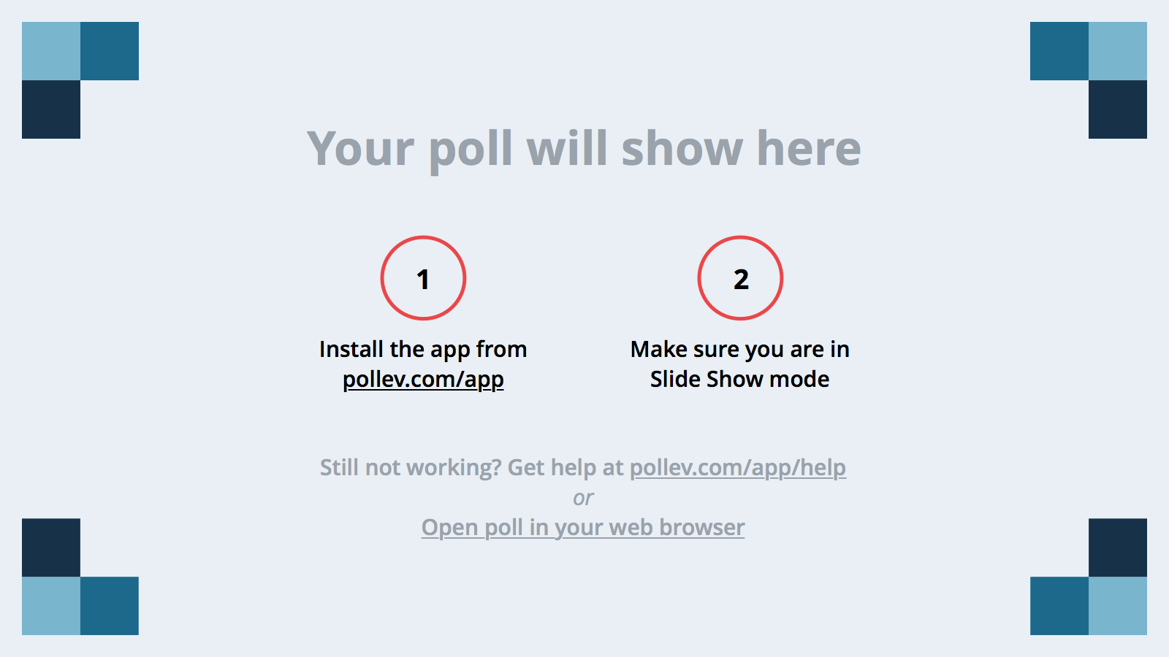
Notes:
Poll Title: How would you define Transit System Redesign in three (3) words? https://www.polleverywhere.com/free_text_polls/Xq12pcPN2D3cvr7

Slide 6
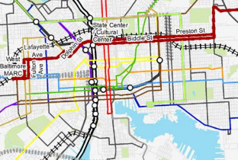
SYSTEM REDESIGN: OUR DEFINITION
Exploring Opportunities
Operations Planning
Network/System Design
Alignments
Levels of Service
Mode Integration
Scheduling
Capital Improvements
Vehicles
Facilities/Garages
On-street Furniture
Capital Investments
Transit Only Lanes
Traffic Signal Priority
Off-Board Fare Payment
Real Time Information
Mobility/Paratransit
Title VI
Administration
Administrative Review
Agency Policy
Strategic Planning
Marketing
Branding
Design
Published Information

Slide 7
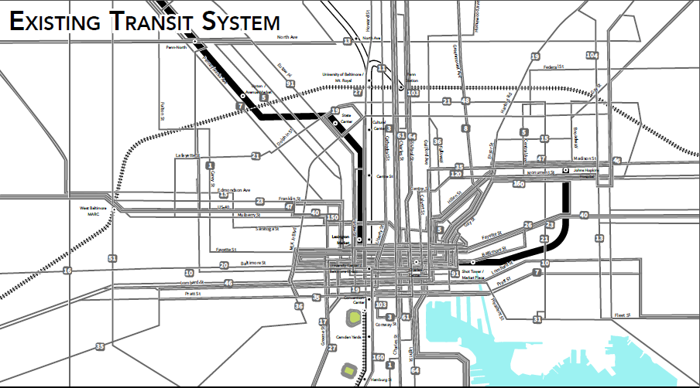
BALTIMORE, MD: Current MTA System

Slide 8
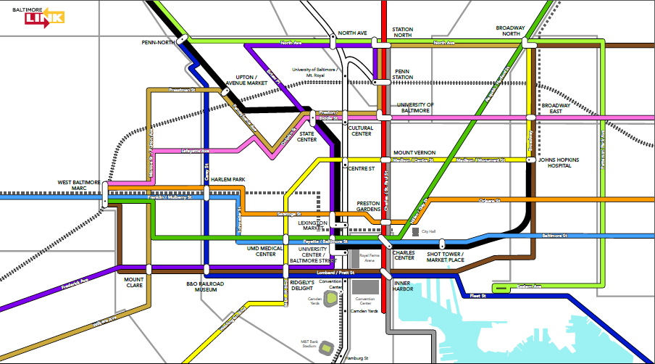
BALTIMORE, MD: BaltimoreLink System (In Design)
SUPERSEDED

Slide 9
BLACKSBURG, VA: Current Blacksburg Transit System

Slide 10
BLACKSBURG, VA:
Proposed Blacksburg
Transit System
(FY2017 Expected Implementation)

Slide 11
MARTINSBURG, WV: EPTA System (Before Redesign)

Slide 12
MARTINSBURG, WV: Current
EPTA System
(Implemented
Fall 2016)

Slide 13
WHY PERFORM A SYSTEM REDESIGN?
BaltimoreLink
EPTA TDP
Blacksburg Transit
Route Analysis

Slide 14
Notes:
Poll Title: What is the top reason a transit agency should consider a redesign? https://www.polleverywhere.com/free_text_polls/CMIpjOaVOCqbreV

Slide 15
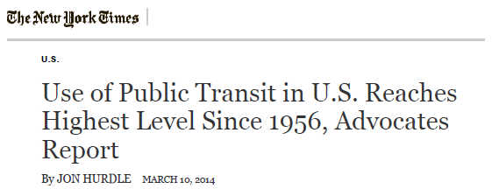
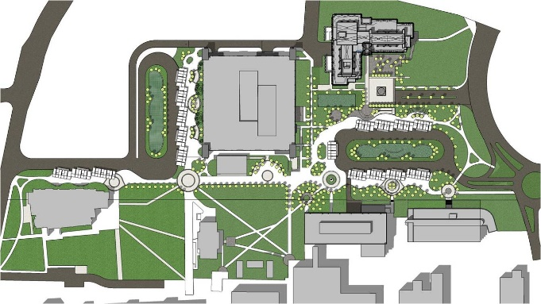
WHY TRANSIT AGENCIES CONDUCT SYSTEM REDESIGNS
Aging transit system
Changing perception of transit
Other planning projects
Changing demographics
Changing travel patterns
Greater availability of in-depth data
Political will
Administrative changes
Funding availability
Etc., etc., etc.

Slide 16
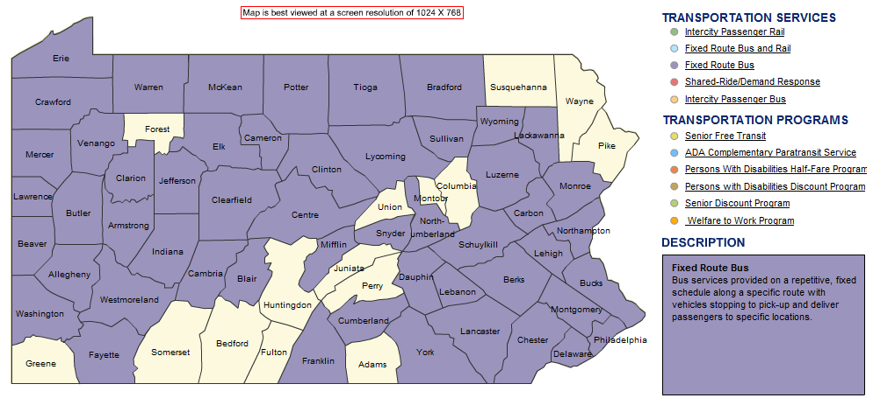
ADDITIONAL REASONS TO EXPLORE SYSTEM REDESIGN IN PENNSYLVANIA
Consolidation efforts
ACT 44 Performance
Improve system efficiency and effectiveness
Access to jobs
Changing/increased land-use and greenfield development

Slide 17
BACKGROUND: BaltimoreLink
Aging system lacking a comprehensive vision
Recent and on-going ridership loss
On-time performance issues
Severe bus bunching
Routes designed to serve too few corridors
Extremely long and cumbersome service alignments
Missed trips and pull-out issues
Politics

Slide 18
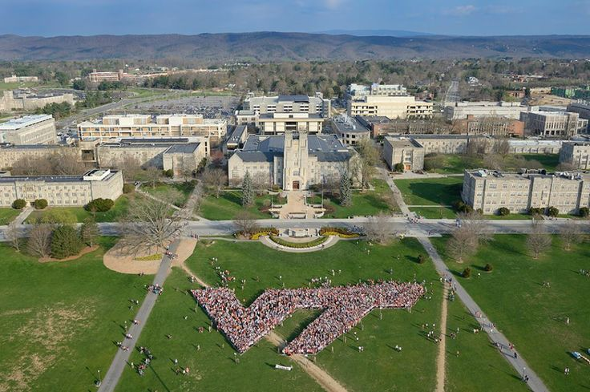
BACKGROUND: Blacksburg Transit Route Analysis
Re-center system around new Multi-Modal Transit Facility and away from Virginia Tech Drillfield
Minimize system “pass-by” issue
Improve service to Town of Blacksburg
Improve service to expanding Virginia Tech Campus
School year versus off-season service

Slide 19
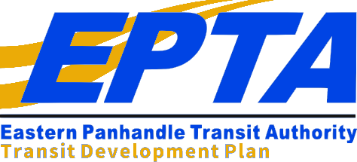
BACKGROUND: EPTA TDP
Aging system
System re-branding
Long and circuitous routes that try to do too much
Administrative changes
Changing demographics and travel patterns
Expected job market growth
Continued residential development

Slide 20
SYSTEM REDESIGN: OUR APPROACH
Goals and Objectives
Data Collection
REDESIGNED
TRANSIT
SYSTEM
System Assessment
Service Area Analysis
Collaborative Service Planning Efforts
Multi-Phased Public Outreach
Efforts

Slide 21
DATA COLLECTION & ANALYSIS
BaltimoreLink
EPTA TDP
Blacksburg Transit
Route Analysis

Slide 22
Notes:
Poll Title: How do you weigh the importance of quantitative vs. qualititative data in an existing conditions analysis? https://www.polleverywhere.com/multiple_choice_polls/0UW0R5WQ05mRzw8

Slide 23
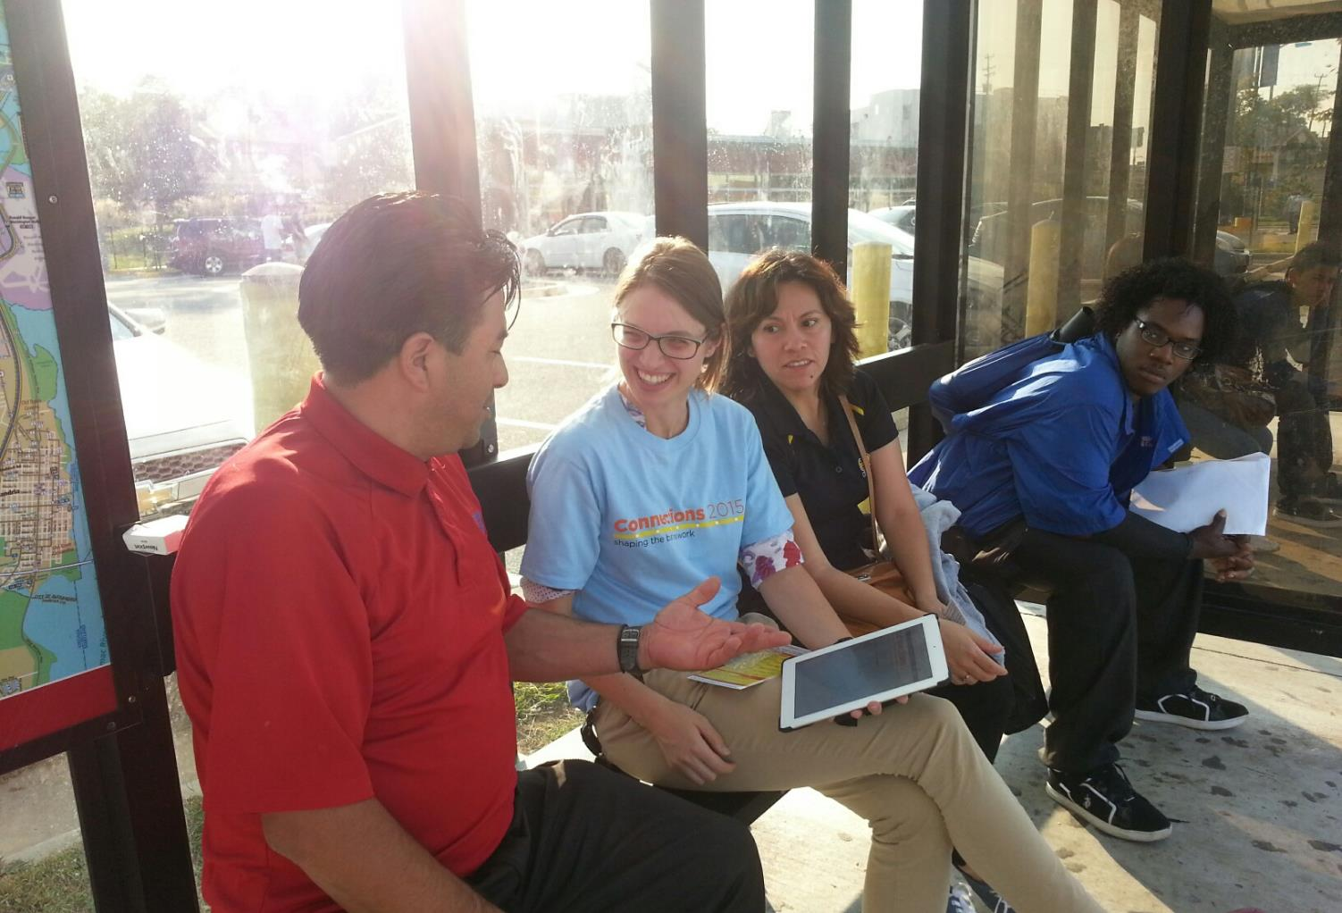
QUANTITATIVE VS. QUALITATIVE DATA
WE CONSIDER QUANTITATIVE & QUALITATIVE DATA EQUALLY IMPORTANT
While quantitative data is important to measure the success of a system in supplying transit to its service area, it only tells part of the story
Qualitative input provides further background and insights regarding the quantitative data
Taking stock of the population’s transit stories, individually, brings a sense of reality to the quantitative analyses
These are the people we are working for, it is imperative to understand their wants, needs, and desires

Slide 24
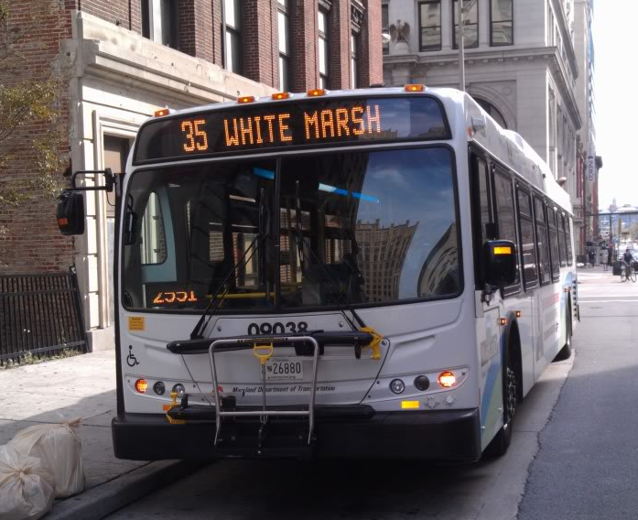
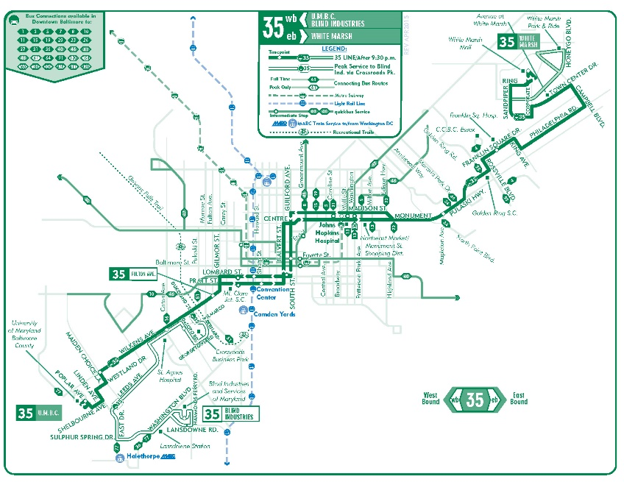
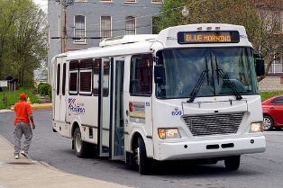
QUANTITATIVE ANALYSIS: Transit System Data
System and Route Level Data
Revenue and Total Hours and Miles
Performance Measures
Route, segment, and stop level data
Ridership
On-time performance
Capacity
Transfer
Most recently available & 5-10 years of trend data
AVL
APC
Farebox
System costs
Anything the agency is willing to provide!
Notes:
Good: availability of more data than ever!
Bad: having to collect and validate, and then re-collect if necessary
The ugly: much data has to be scrubbed and tweaked to be able to use it – many transit agencies have data issues: how to store it, how to access it, what to do with it, how to validate it, etc.

Slide 25
QUANTITATIVE ANALYSIS: Transit Need
Our Transit Propensity Index
57 indicators of transit need
Aggregate
Density
Percentage of total population
Indicators divided into four categories:
Transit dependent population – Origins
Transit dependent population – Destinations
Commuter population – Origins
Commuter population – Destinations
Regional origin-destination model inputs

Slide 26
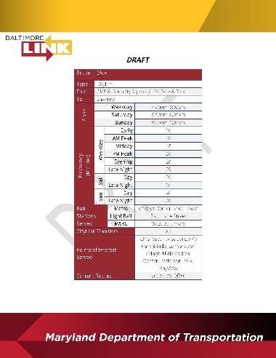
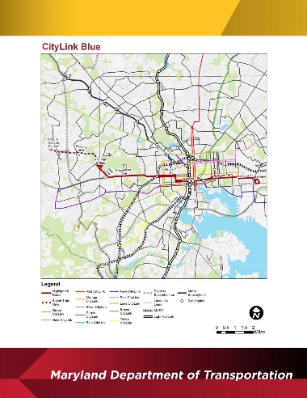
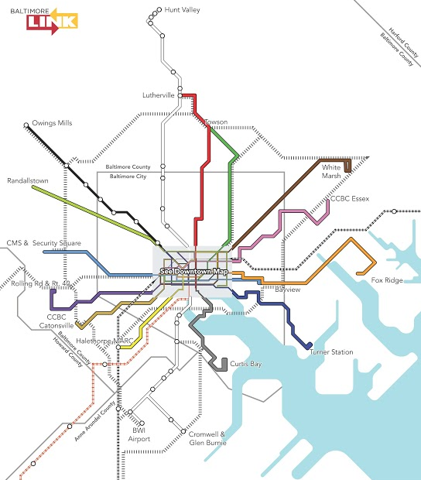
QUALITATIVE DATA Outreach
Multi-phased (upwards of SIX phases)
Phase I: System desires/needs
Phase II: Existing conditions and trade-off exercises
Phase III: Presentation of early recommendations
Phase IV: Presentation of revised recommendations
Phase V: Public hearings
Phase VI: Public education
Event Types
On-board surveys
Workshops
Pop-ups
Stakeholder meetings
Focus groups

Slide 27
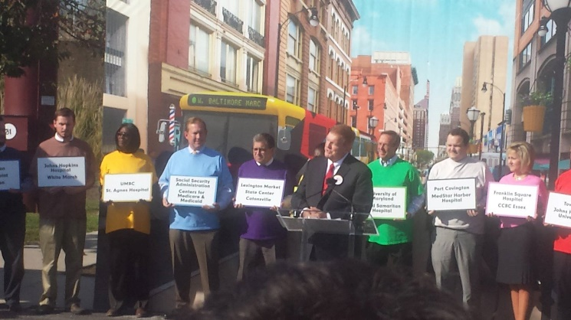
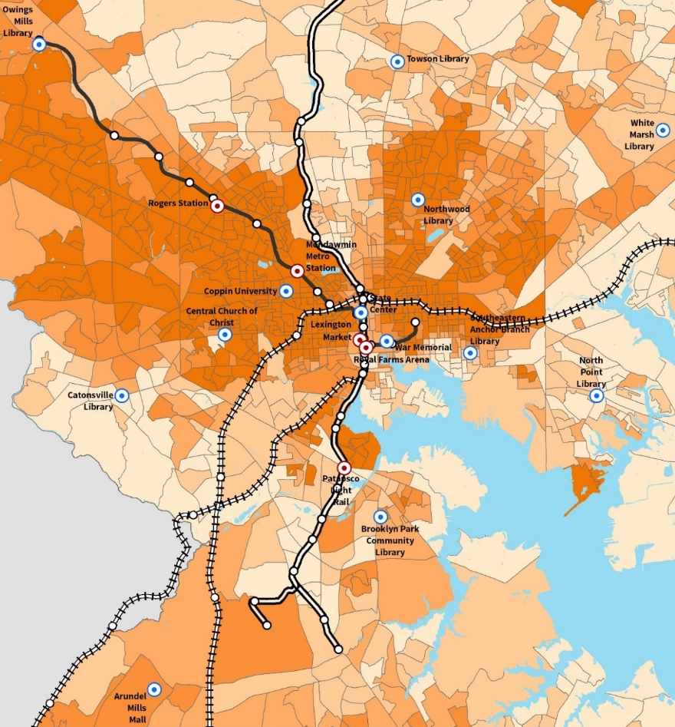
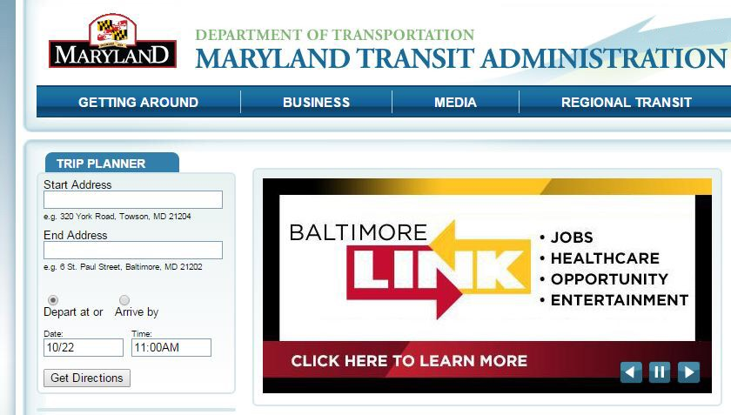
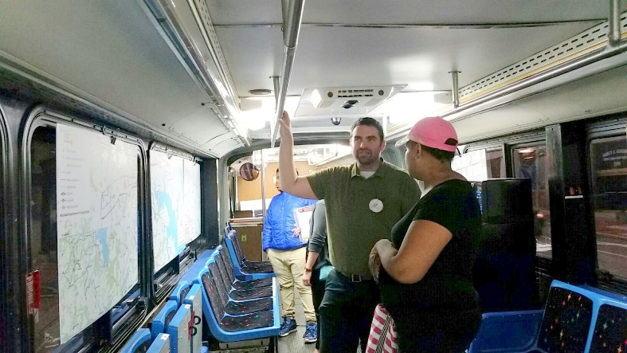
OUTREACH: BaltimoreLink
Multi-phased approach (through BNIP and BaltimoreLink)
Event types
Workshops
Pop-up events
Community group meetings
Stakeholder group meetings
Project website
mySideWalk: interactive online, social media hub
Project hotline
Political liaison
Public hearings
Public education

Slide 28
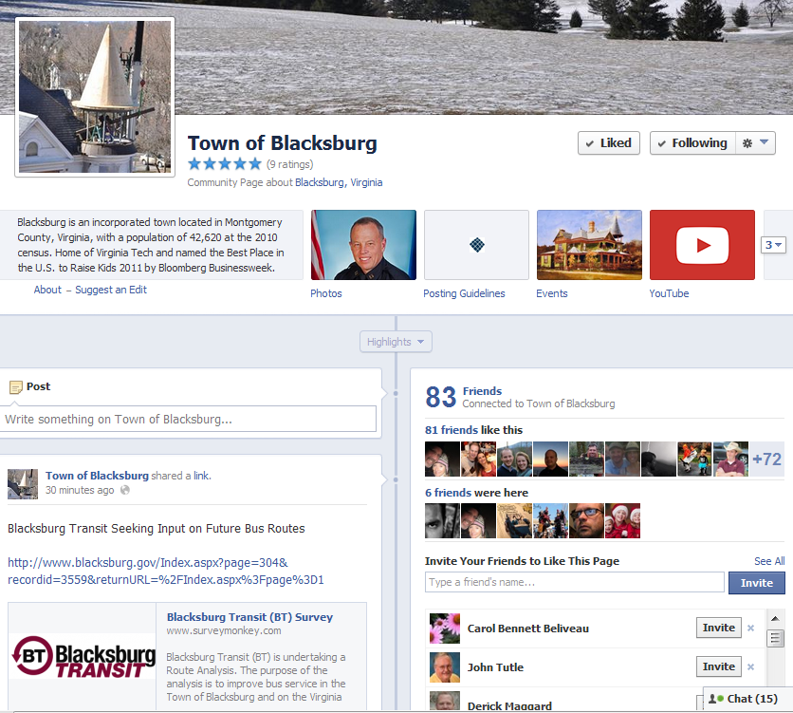
OUTREACH: Blacksburg Transit Route Analysis
Extensive online survey effort
Town of Blacksburg residents
Virginia Tech students
Virginia Tech staff
Stakeholder group interviews
Operator Interviews

Slide 29
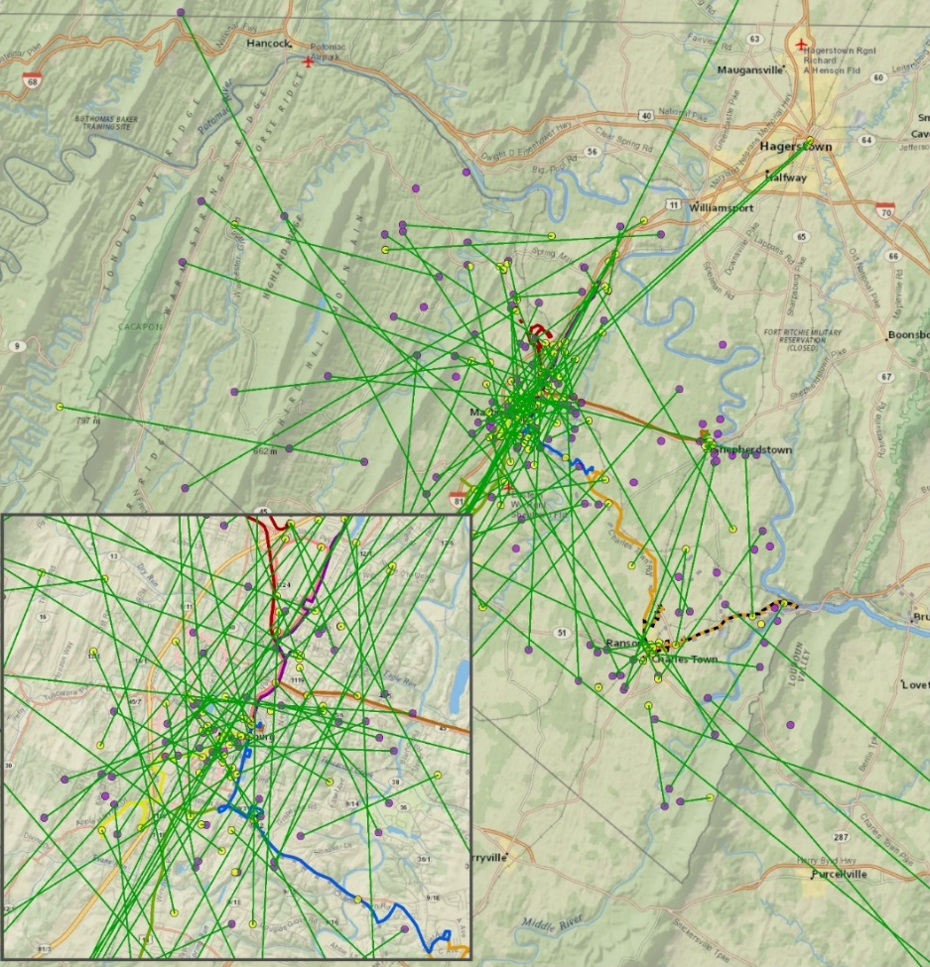
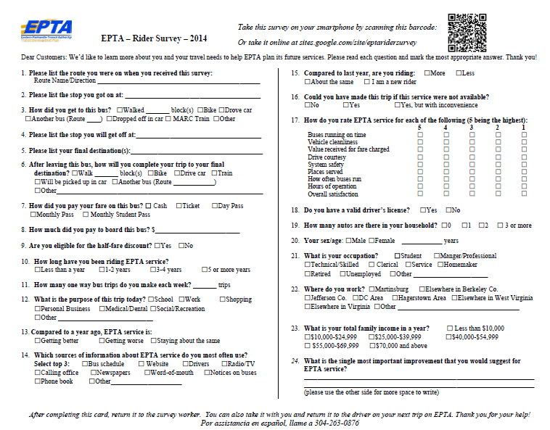
OUTREACH: EPTA TDP
Passenger survey
Online residential survey
Stakeholder group meetings
Focus group interviews
Planning charrette
Operator meetings

Slide 30
PLANNING PROCESS
BaltimoreLink
EPTA TDP
Blacksburg Transit
Route Analysis

Slide 31
Notes:
Poll Title: Who needs to be at the table in the transit system redesign planning process? https://www.polleverywhere.com/free_text_polls/IKh2100p2wtUUyS

Slide 32
OUR PLANNING PROCESS: Collaborative Service Planning
WHO DO WE INCLUDE?
Everyone who is willing to participate
Agency administration, division directors, planners, schedulers and select operators and supervisors
Area stakeholders
Select riders
HOW DOES THE PROCESS WORK?
Organized chaos!
Multiple meetings
First to consider route alignments, then to address levels of service
Every opinion is considered
Technology is used to speed the process
WHAT ARE THE BENEFITS?
All decision makers are in the room
While the planning process may seem slower at first, planning efforts are completed more quickly
Faster approval from administration

Slide 33
WHAT COMES OUT OF THE CRACKS
BaltimoreLink
EPTA TDP
Blacksburg Transit
Route Analysis

Slide 34
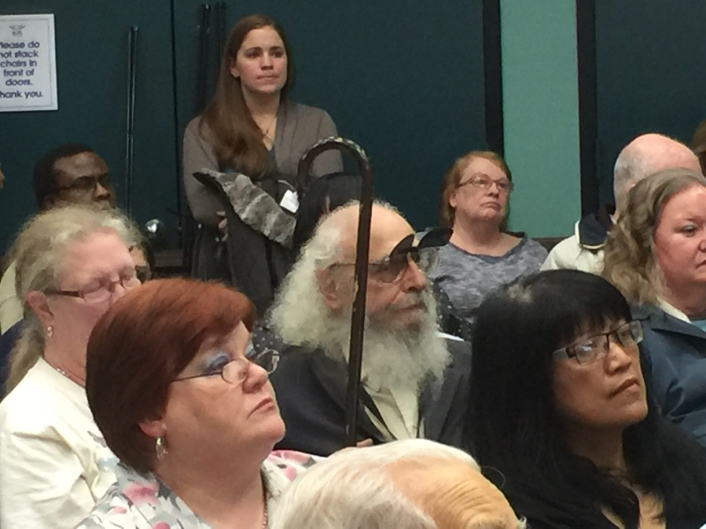
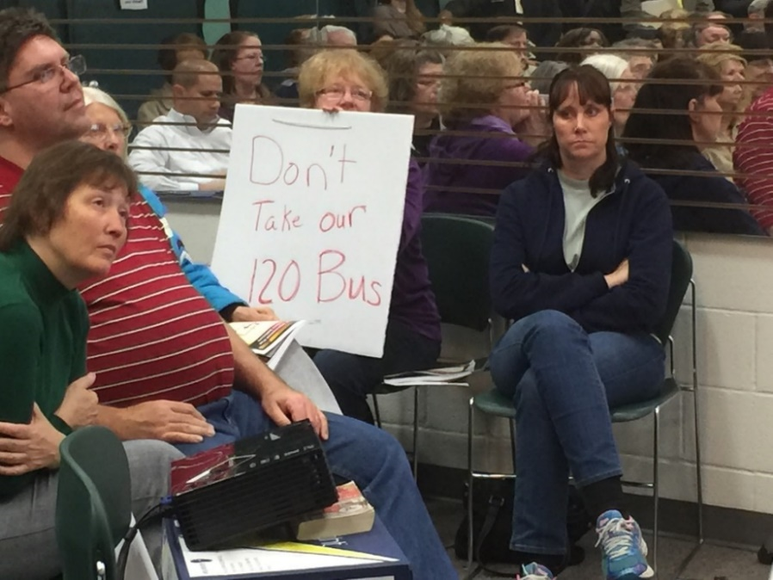
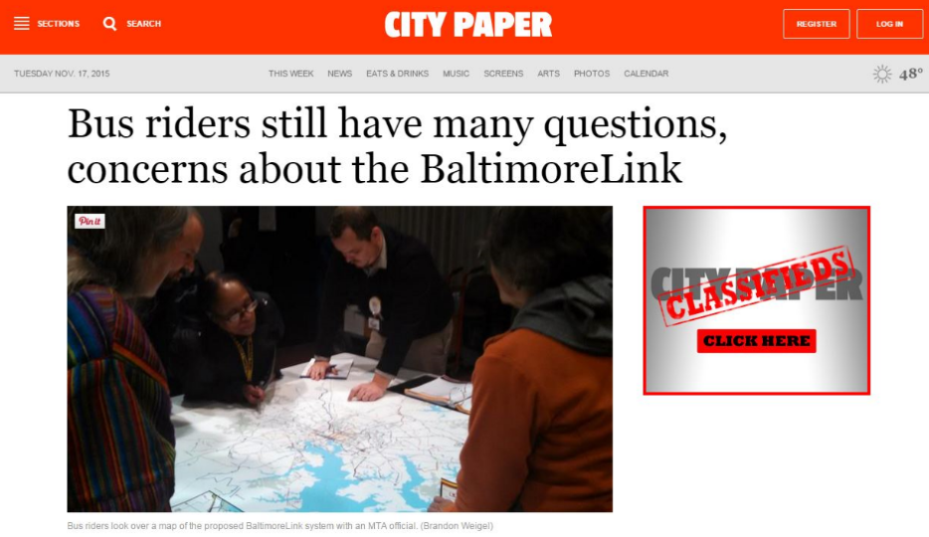
SYSTEM REDESIGN: What Comes Out of the Cracks
“Everyone is a service planner”
Transit “Experts”
YELLING!!!!
Trolls
Politics
Press coverage
Positive/Negative/Neutral
Title VI implications
Overall Stress
On the agency, on the consultants, on the city/region, and on the residents

Slide 35
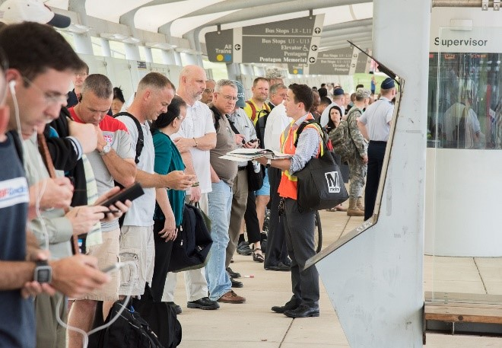
IS IT WORTH IT FOR AGENCIES TO CONDUCT SYSTEM REDESIGNS?
Without question!
Process allows for all facets of a transit system to be evaluated and turned on its head
Resulting new system can be a boon to a transit agency
EPTA’s redesigned system (implemented in mid-2015) increased its ridership by over 60% in the first few months, with even more growth expected!

Slide 36
QUESTIONS & ANSWERS
Joshua Diamond
jdiamond@foursquareitp.com

